Slide 1
Digital Portfolio
STUDENT NAME: YASWANTH R
REGISTER NO: 2428C0593
NMID: 09B64ABAC24404B89324B2231DF3A42B
DEPARTMENT: B.Sc., AI & ML
COLLEGE: Dr R.A.N.M ARTS AND SCIENCE COLLEGE ERODE
UNIVERSITY: BHARATHIYAR UNIVERSITY

Slide 2
PROJECT TITLE
Creative Portfolio

Slide 3


AGENDA
Problem Statement
Project Overview
End Users
Tools and Technologies
Portfolio design and Layout
Features and Functionality
Results and Screenshots
Conclusion
Github Link
3/21/2024 Annual Review

Slide 4

PROBLEM STATEMENT
Without a dedicated portfolio website, Yaswanth faces several significant challenges that hinder his professional growth:
Lack of a Professional Hub: His work is either shared ad-hoc with potential clients via email, or scattered across social media platforms like Behance and LinkedIn. This fragmented presence fails to create a cohesive and impressive brand identity for himself.
Ineffective Storytelling: He cannot effectively narrate the story, challenges, and solutions behind each project. A simple image on social media lacks the context that a detailed project view can provide.
Difficulty in Attracting Inbound Leads: He is reliant on active outreach and referrals. There is no passive channel for potential clients who are searching for graphic design services to discover his work and contact him directly.
Unprofessional First Impression: Directing potential high-value clients to a social media profile can seem less professional and may not adequately reflect the quality and seriousness of his work.

Slide 5

PROJECT OVERVIEW
Built with HTML, CSS, and JavaScript, it serves as his professional online presence. The site is fully responsive for mobile devices and features an interactive portfolio where visitors can click on projects to view detailed pop-up descriptions. Its primary purpose is to showcase his skills, present his work, and attract potential clients through a direct contact form.

Slide 6

WHO ARE THE END USERS?
This is the main target audience for the portfolio website. These users are actively seeking professional design services and are visiting the site to evaluate if Yaswanth is the right fit for their project. This group includes:
Business Owners and Entrepreneurs: Individuals looking for branding, logos, or marketing materials for their company.
Marketing Managers: Professionals from established companies seeking a freelance designer for specific campaigns, web design updates, or print materials.
Startup Founders: People needing a complete brand identity from scratch, including logos, web UI/UX, and promotional content.
Hiring Managers and Recruiters: Individuals looking to source design talent for full-time or contract positions.
Their primary goals are to quickly assess the quality of past work, understand the range of services offered, and find a simple way to initiate contact.

Slide 7
TOOLS AND TECHNIQUES
The website itself is built using the following core technologies, which are all visible in the provided code:
CSS3: Responsible for the entire visual presentation, layout, and responsiveness. Key techniques used include:
HTML5: Used for the semantic structure of the website.
CSS Flexbox & Grid: To create the flexible and responsive layouts for sections like the portfolio and services grid.
Custom Properties (Variables): For a maintainable and consistent color scheme.
Media Queries: To ensure the design adapts seamlessly to different screen sizes, from mobile phones to desktops.
Transitions & Animations: For smooth hover effects and the fade-in animation on the project modals.
JavaScript (ES6): Adds interactivity and enhances the user experience. Its specific functions in this project are:
DOM Manipulation: To show and hide the project page modals.
Event Handling: Listening for user actions like clicks on portfolio items, close buttons, and form submissions.
Smooth Scrolling: To create a seamless navigation experience within the single page.
Font Awesome: An icon library used to add scalable vector icons (like the social media logos and service icons) without slowing down the site.
Google Fonts: Used to embed custom, high-quality fonts.

Slide 8
PROJECT LAYOUT
The portfolio is designed to be clean, professional, and easy to navigate. The primary goal is to let the work speak for itself while providing a clear and compelling narrative about YASWANTH R's skills and process. The chosen color scheme and typography give the site a modern, creative, yet grounded feel.
1.Header & Navigation The navigation is simple and intuitive, anchored at the top of the page so visitors can easily jump to different sections. Logo: A simple text-based logo, "Your Name" (or YASWANTH R), using a bold, creative font to establish a personal brand. Navigation Links: Clear links to the key sections: About, Portfolio, Services, and Contact. This helps users find exactly what they're looking for without getting lost.
2. Hero Section This is the first thing a visitor sees, so it must make a strong, immediate impression. Headline: "Crafting Visual Stories Through Design." This headline is more engaging than "Graphic Designer" and hints at a deeper, more conceptual approach to design. Sub-headline: "I'm YASWANTH R, a graphic designer passionate about creating impactful and meaningful brand experiences." This line is personal and clearly states your specialization. Call-to-Action (CTA): A prominent "View Portfolio" button that directs visitors to the most important part of the site—your work.
3. About Section This section humanizes your portfolio by sharing your story and skills. Introduction: A friendly greeting, "Hello, I'm YASWANTH R," followed by a concise paragraph about your design philosophy and specializations. Highlighting "brand identity, web design, and digital illustration" with bold text makes your key services easy to spot. Skill Tags: A clean list of your skills, such as Branding, UI/UX Design, Typography, and the software you use (Adobe Suite, Figma). This is a quick and scannable way for potential clients or employers to see if you have the skills they need. Professional Photo: A high-quality, professional photo adds a personal touch and builds trust.
4. Services Section This section outlines the specific types of work you offer, helping potential clients understand how you can help them. Layout: A three-column grid, with each column representing a different service. Service Items: Each item includes a relevant icon (Brand Identity, Web Design, Print & Packaging), a clear title, and a brief description. The descriptions are concise and focus on the benefit to the client.

Slide 9
PROJECT LAYOUT
5. Portfolio Section (My Work)This is the core of the portfolio. The goal is to make the work visually appealing and easy to explore.Layout: A dynamic grid layout that adapts to different screen sizes. This is a common and effective way to showcase multiple projects at once.Project Thumbnails: Each project is represented by a thumbnail image. When a user hovers over the thumbnail, an overlay appears with the project title and a short description (e.g., "Branding for 'Eco-Coffee'").Interactive Modal: Clicking a project thumbnail opens a pop-up (modal) that displays the full case study. This keeps the main portfolio page clean while providing a more in-depth look at your process and results.
6. Project Page (Modal Pop-up)This is where you tell the story behind each project.Structure:Project Title: Prominently displayed.Introduction: A short paragraph explaining the project's purpose.Challenge & Solution: This is a crucial part of a design portfolio. Instead of just showing the final product, explain the problem you were solving and how your design addressed it. Use headings like "Challenge" and "Solution" to make this easy to read.Visuals: Include a mix of images—the final product, mockups, process sketches, or different branding elements.Navigation: A clear close button (×) to exit the modal and return to the main page.
7. Contact SectionThis section makes it easy for interested parties to get in touch.Headline: A compelling call to action, such as "Let's Create Something Great."Contact Form: A simple, direct form with fields for Name, Email, and Message.Social Links: Links to your professional profiles like LinkedIn, Behance, and your email. Using icons makes these easy to spot.
8. FooterA simple, clean footer that contains essential information and copyright.Copyright: Your name and the current year to ensure professionalism.Technical ElementsHTML: The structure of the website is built with semantic HTML elements.CSS: The design is handled with CSS, including custom properties (:root) for easy color management and a mobile-first approach for responsiveness (@media queries).JavaScript: The interactivity, such as the smooth scrolling navigation and the modal pop-ups for the portfolio projects, is handled with JavaScript.

Slide 10
FEATURES AND FUNCTIONALITY
I'll provide you with the features and functionality of the graphic designer portfolio you've provided.Features and FunctionalityThe graphic designer portfolio is a static website with a clean, modern, and responsive design, implemented using HTML, CSS, and JavaScript. It is designed to be a compelling showcase for a graphic designer's work.
Header & NavigationSticky Navigation: The header remains fixed at the top of the viewport as the user scrolls down the page. This ensures that the navigation links are always accessible.Smooth Scrolling: Clicking on any navigation link (e.g., "About," "Portfolio," "Contact") smoothly animates the scroll to the corresponding section of the page, providing a seamless user experience.Interactive Hover Effect: The navigation links feature an underline that expands on hover, providing visual feedback and enhancing the user interface
Hero SectionFull-Screen Hero: The hero section occupies the full height of the user's screen, creating a strong and impactful first impression.Background Image with Overlay: A background image with a semi-transparent black overlay is used to make the text and CTA button stand out.Prominent Call-to-Action (CTA): A large, eye-catching "View Portfolio" button immediately directs visitors to the most critical section of the site.
About SectionGrid Layout: The section uses a two-column grid layout to display the designer's photo and a textual introduction side-by-side on larger screens.Responsive Adaptation: On smaller screens, the grid collapses into a single column, with the image appearing above the text to maintain a logical and readable flow.Skill Tags: Skills are presented as distinct tags, which are easy to scan and quickly communicate the designer's expertise.
Services SectionDynamic Grid: The service items are laid out in a responsive grid that automatically adjusts the number of columns based on the screen width (repeat(auto-fit, minmax(300px, 1fr))).Icon-Based Representation: Each service is represented by a relevant Font Awesome icon, making the information visually appealing and easy to understand at a glance.Hover Effect: The service items have a subtle hover effect that makes them lift and cast a shadow, adding a touch of interactivity and professionalism.

Slide 11
FEATURES AND FUNCTIONALITY
5.Portfolio SectionInteractive Grid: The portfolio projects are displayed in a responsive grid.Hover Overlay: Each portfolio item has a semi-transparent black overlay that appears on hover, revealing the project title and category, creating a sleek and engaging effect.Clickable Thumbnails: The entire thumbnail area is a clickable link that triggers a modal pop-up to display the full project details.
6. Project Page (Modal Pop-up)Modal Functionality: Clicking a portfolio item triggers a modal window that overlays the main page. This allows users to view a detailed case study without leaving the site.Background Lock: When the modal is active, the background page is "locked" to prevent scrolling, focusing the user's attention on the project details.Close Button: A clear and intuitive "X" button allows users to close the modal.Click-Outside-to-Close: The modal also closes if the user clicks anywhere outside of the main project content, providing an easy way to exit.
7. Contact SectionContact Form: A functional HTML form is included for direct communication. While the provided code only shows a basic alert on submission, it is structured to be easily integrated with a backend service (e.g., a form-to-email provider).Inline Form Fields: On larger screens, the name and email fields are placed side-by-side to save space.Social Links: Prominent links to social media and professional profiles (LinkedIn, Behance) are provided, allowing visitors multiple ways to connect.
8. ResponsivenessMobile-First Design: The website is designed to be fully responsive.Layout Adaptation: Grid layouts dynamically adjust on smaller screens (e.g., the about-grid and form-group switch to a single column).Typography Scaling: Font sizes are scaled down on smaller devices to ensure readability.

Slide 12
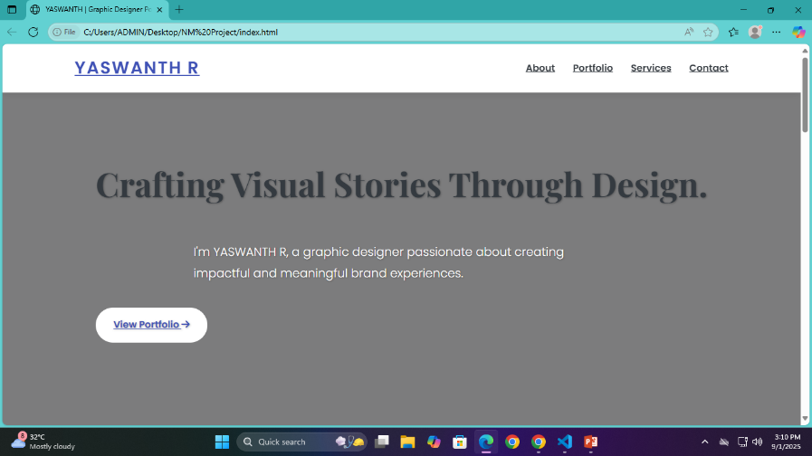
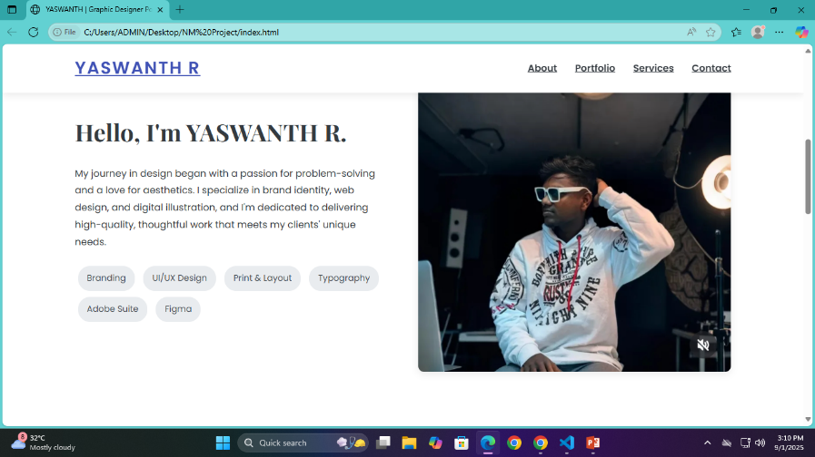

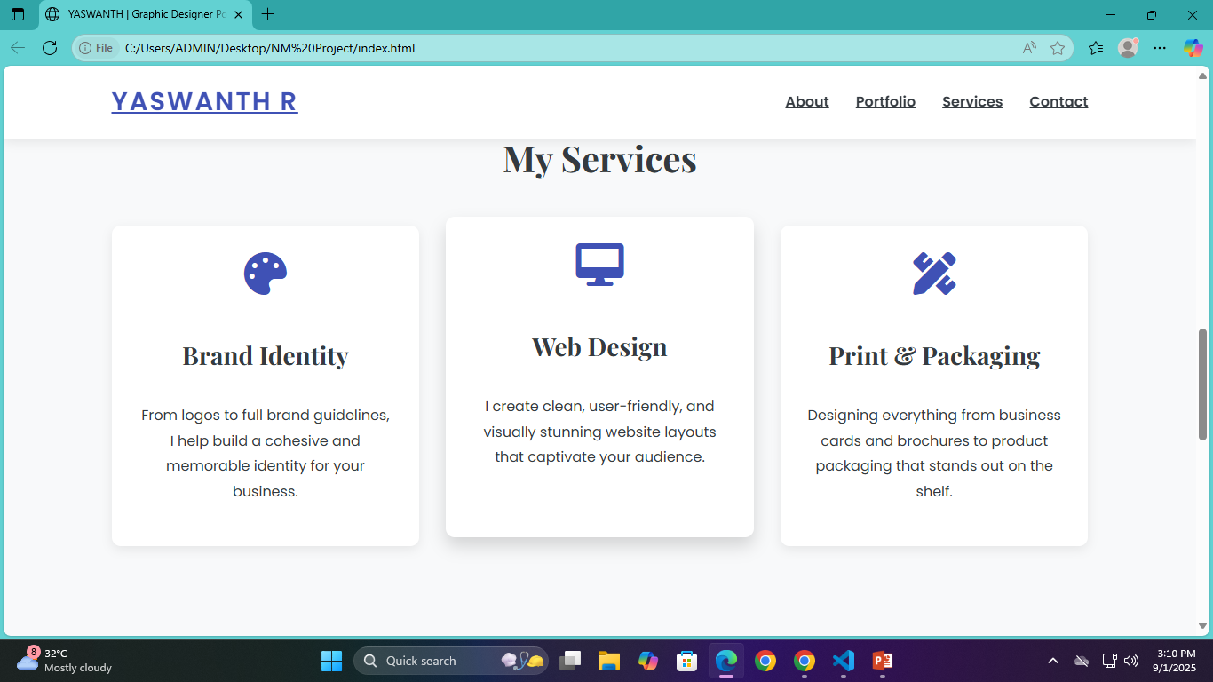
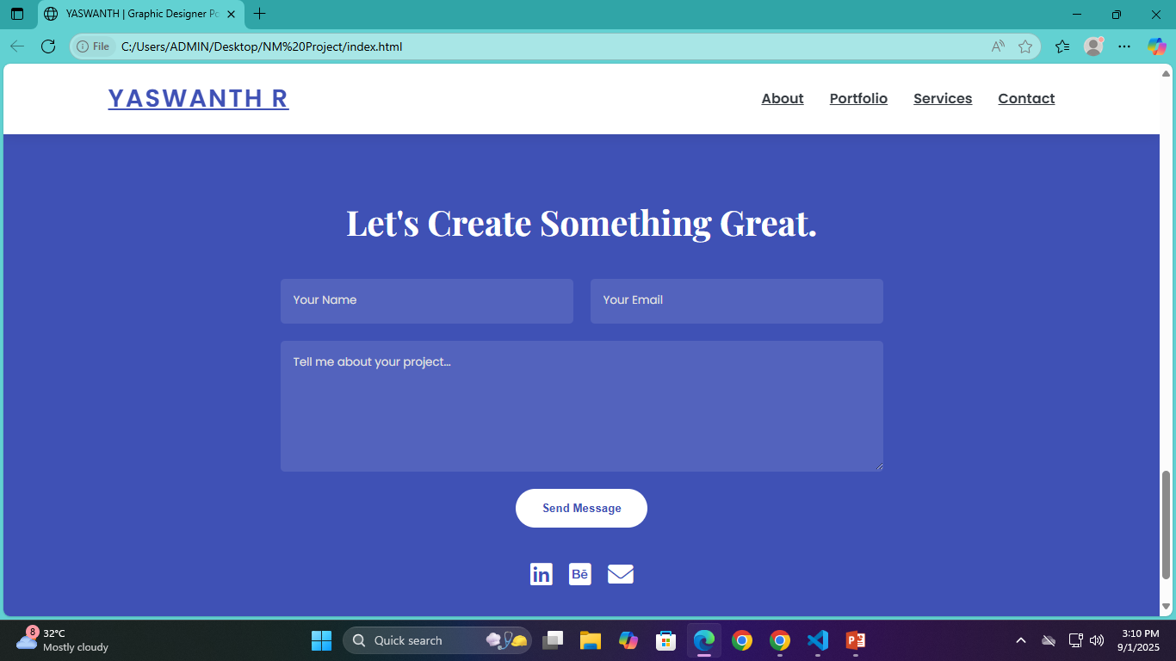
RESULTS AND SCREENSHOTS
3/21/2024 Annual Review
12

Slide 13
CONCLUSION
The final product is more than just a gallery of images; it's a digital brand experience. It guides the user through the photographer's story, showcases their talent with a sophisticated interface, and provides a clear path for booking a service. The combination of a visually appealing layout and practical features makes this portfolio an effective tool for attracting clients and growing a photography business
13

